Slide 1
ITNW 1335 Cloud Computing
Chapter 7 – Cloud Infrastructure Mechanisms

Slide 2
Cloud Infrastructure Mechanisms
Cloud infrastructure mechanisms are foundational building blocks of cloud environments that establish primary artifacts to form the basis of fundamental cloud technology architecture.
The cloud infrastructure mechanisms are:
Logical Network Perimeter
Virtual Server
Cloud Storage Device
Cloud Usage Monitor
Resource Replication
Ready-Made Environment
Not all of these mechanisms are necessarily broad-reaching, nor does each establish an individual architectural layer.
They should be viewed as core components that are common to cloud platforms.

Slide 3

7.1. Logical Network Perimeter
Defined as the isolation of a network environment from the rest of a communications network
Establishes a virtual network boundary that can encompass and isolate a group of related cloud-based IT resources that may be physically distributed
Implemented to:
isolate IT resources in a cloud from non-authorized users
isolate IT resources in a cloud from non-users
isolate IT resources in a cloud from cloud consumers
control the bandwidth that is available to isolated IT resources
Figure 7.1 The dashed line notation used to indicate the boundary of a logical network perimeter.
Notes:
Figure:

Slide 4
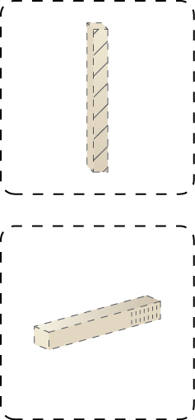
7.1. Logical Network Perimeter
Logical network perimeters are typically established via network devices that supply and control the connectivity of a data center and are commonly deployed as virtualized IT environments that include:
Virtual Firewall – An IT resource that actively filters network traffic to and from the isolated network while controlling its interactions with the Internet
Virtual Network – Usually acquired through VLANs, this IT resource isolates the network environment within the data center infrastructure.
Figure 7.2 The symbols used to represent a virtual firewall (top) and a virtual network (bottom).
Notes:
Figure:

Slide 5
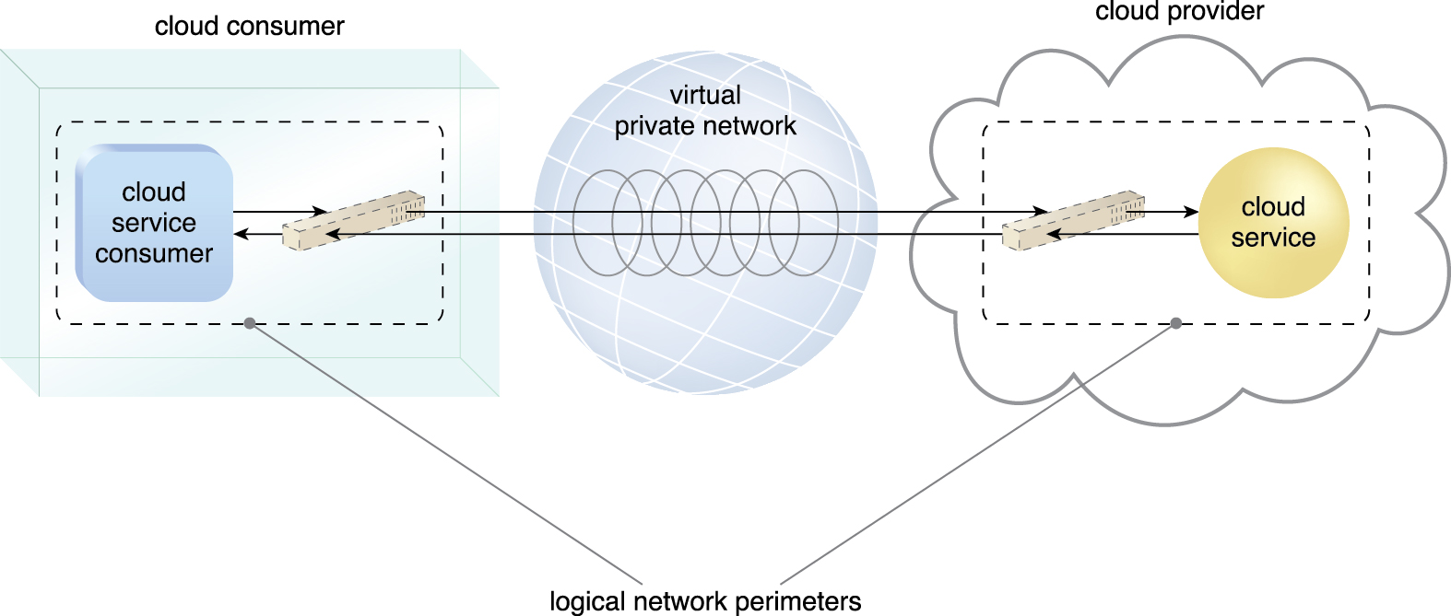
7.1. Logical Network Perimeter
The perimeters, in this case below, are connected through a VPN that protects communications, since the VPN is typically implemented by point-to-point encryption of the data packets sent between the communicating endpoints
Figure 7.3 Two logical network perimeters surround the cloud consumer and cloud provider environments.
Notes:
Figure:

Slide 6
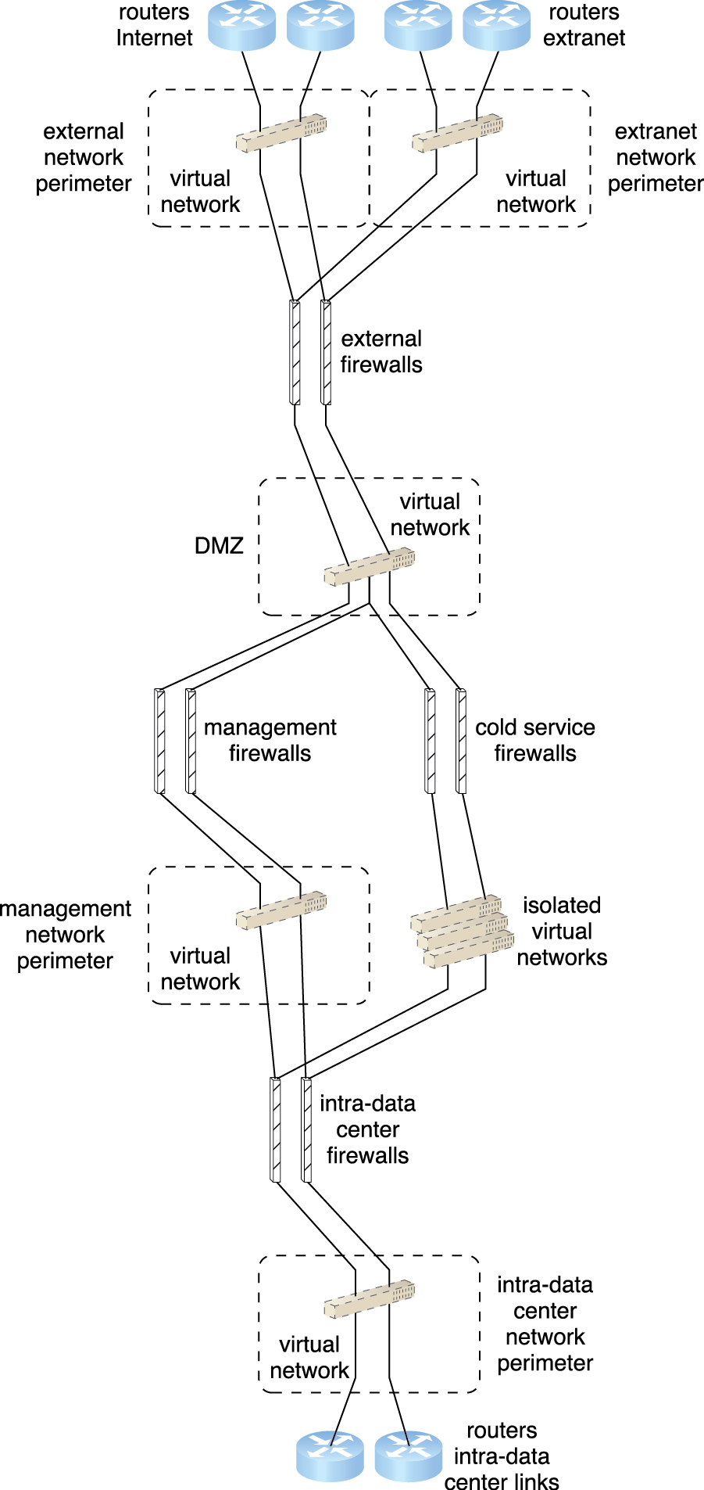
Case Study Example
A logical network layout is established through a set of logical network perimeters using various firewalls and virtual networks.
Figure 7.4
Notes:
Figure:

Slide 7
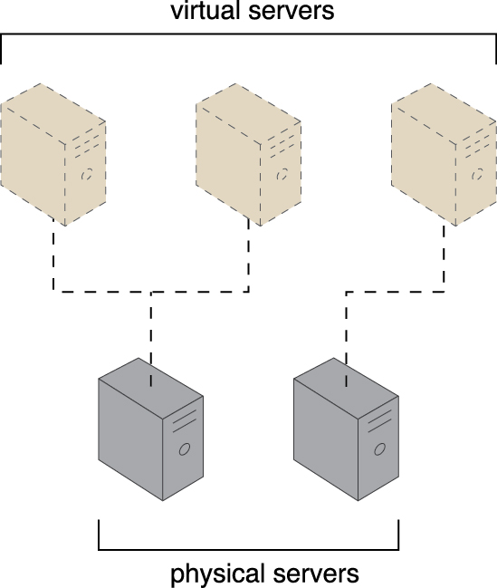
7.2. Virtual Server
A virtual server is a form of virtualization software that emulates a physical server
Virtual servers are used by cloud providers to share the same physical server with multiple cloud consumers by providing cloud consumers with individual virtual server instances.
The number of instances a given physical server can share is limited by its capacity
Figure 7.5 The first physical server hosts two virtual servers, while the second physical server hosts one virtual server.
Notes:
Figure:

Slide 8
7.2. Virtual Server
As a commodity mechanism, the virtual server represents the most foundational building block of cloud environments
Each virtual server can host numerous IT resources, cloud-based solutions, and various other cloud computing mechanisms
The instantiation of virtual servers from image files is a resource allocation process that can be completed rapidly and on-demand.
Cloud consumers that install or lease virtual servers can customize their environments independently from other cloud consumers that may be using virtual servers hosted by the same underlying physical server
Notes:
Figure:

Slide 9
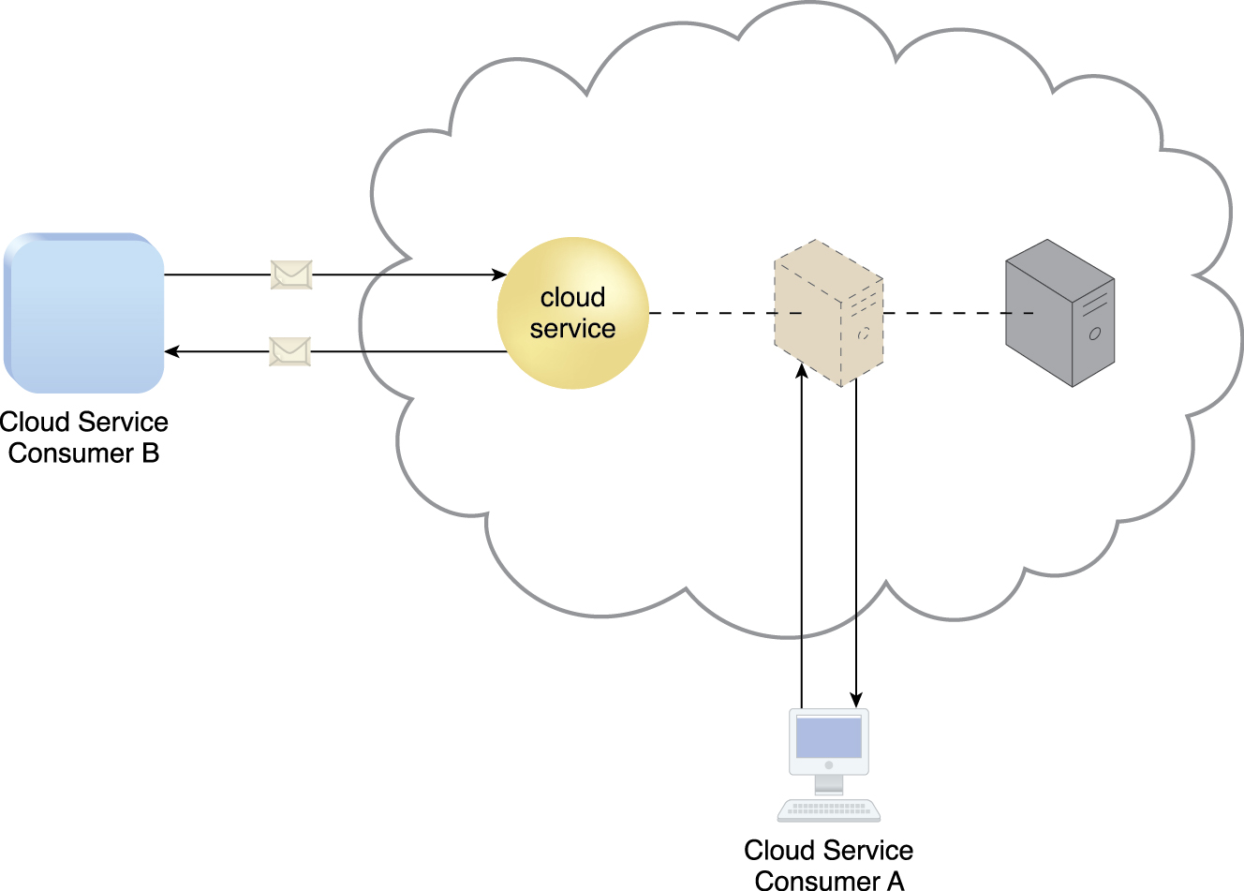
7.2. Virtual Server
Figure 7.6 A virtual server hosts an active cloud service and is further accessed by a cloud consumer
for administrative purposes.
Notes:
Figure:

Slide 10
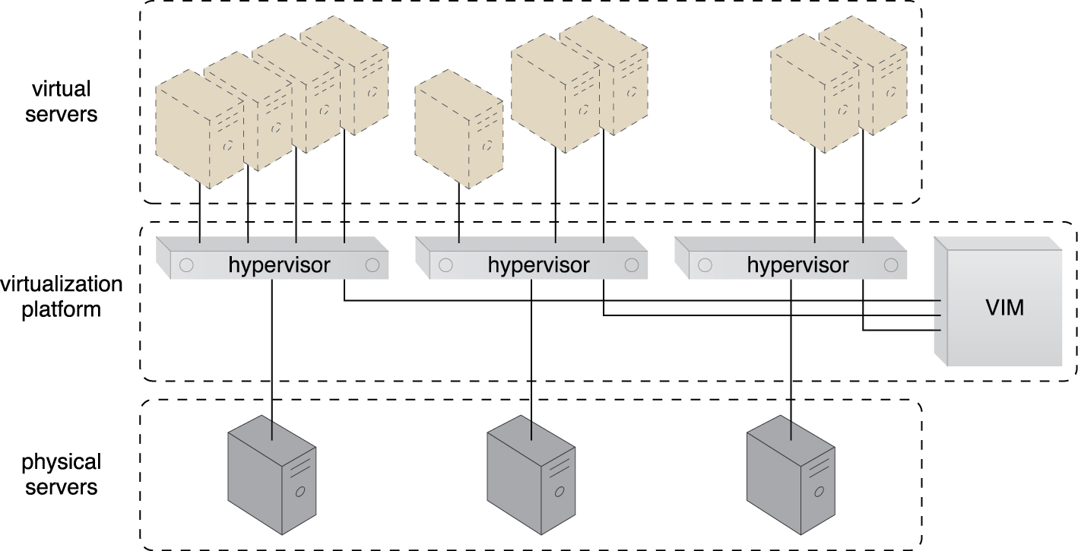
Case Study Example
DTGOV’s IaaS environment contains hosted virtual servers that were instantiated on physical servers running the same hypervisor software that controls the virtual servers
Their VIM is used to coordinate the physical servers in relation to the creation of virtual server instances. This approach is used at each data center to apply a uniform implementation of the virtualization layer
Figure 7.7 Virtual servers are created via the physical servers’ hypervisors and a central VIM.
Notes:
Figure:

Slide 11
Case Study Example
In order to enable the on-demand creation of virtual servers, DTGOV provides cloud consumers with a set of template virtual servers that are made available through pre-made VM images
Figure 7.7 Virtual servers are created via the physical servers’ hypervisors and a central VIM.
Notes:
Figure:

Slide 12
Case Study Example
The following virtual server packages are offered to DTGOV’s cloud consumers. Each package has different pre-defined performance configurations and limitations:
Small Virtual Server Instance – 1 virtual processor core, 4 GB of virtual RAM, 20 GB of storage space in the root file system
Medium Virtual Server Instance – 2 virtual processor cores, 8 GB of virtual RAM, 20 GB of storage space in the root file system
Large Virtual Server Instance – 8 virtual processor cores, 16 GB of virtual RAM, 20 GB of storage space in the root file system
Memory Large Virtual Server Instance – 8 virtual processor cores, 64 GB of virtual RAM, 20 GB of storage space in the root file system
Processor Large Virtual Server Instance – 32 virtual processor cores, 16 GB of virtual RAM, 20 GB of storage space in the root file system
Ultra-Large Virtual Server Instance – 128 virtual processor cores, 512 GB of virtual RAM, 40 GB of storage space in the root file system
Notes:
Figure:

Slide 13
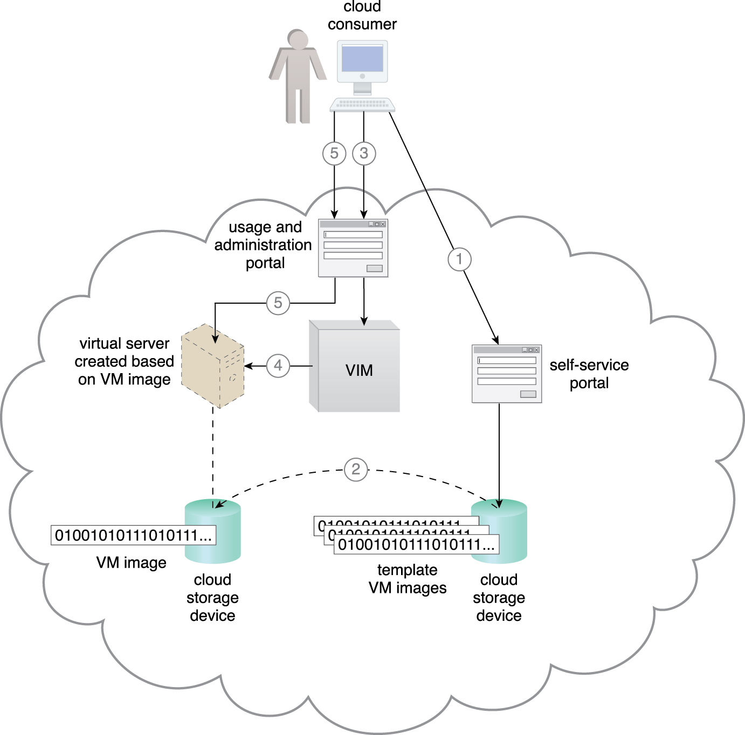
Case Study Example
Figure 7.8 The cloud consumer uses the self-service portal to select a template virtual server for creation (1).
A copy of the corresponding VM image is created in a cloud consumer-controlled cloud storage device (2).
The cloud consumer initiates the virtual server using the usage and administration portal (3),
which interacts with the VIM to create the virtual server instance via the underlying hardware(4).
The cloud consumer is able to use and customize the virtual server via other features on the usage and administration portal (5).
Notes:
Figure:

Slide 14
7.3. Cloud Storage Device
The cloud storage device mechanism represents storage devices that are designed specifically for cloud-based provisioning
Instances of these devices can be virtualized, similar to how physical servers can spawn virtual server images
Cloud storage devices are commonly able to provide fixed-increment capacity allocation in support of the pay-per-use mechanism
Cloud storage devices can be exposed for remote access via cloud storage services
Notes:
Figure:

Slide 15
7.3. Cloud Storage Device - Issues
A primary concern related to cloud storage is the security, integrity, and confidentiality of data, which becomes more prone to being compromised when entrusted to external cloud providers and other third parties.
There can also be legal and regulatory implications that result from relocating data across geographical or national boundaries
Another issue applies specifically to the performance of large databases
LANs provide locally stored data with network reliability and latency levels that are superior to those of WANs
Notes:
Figure:

Slide 16
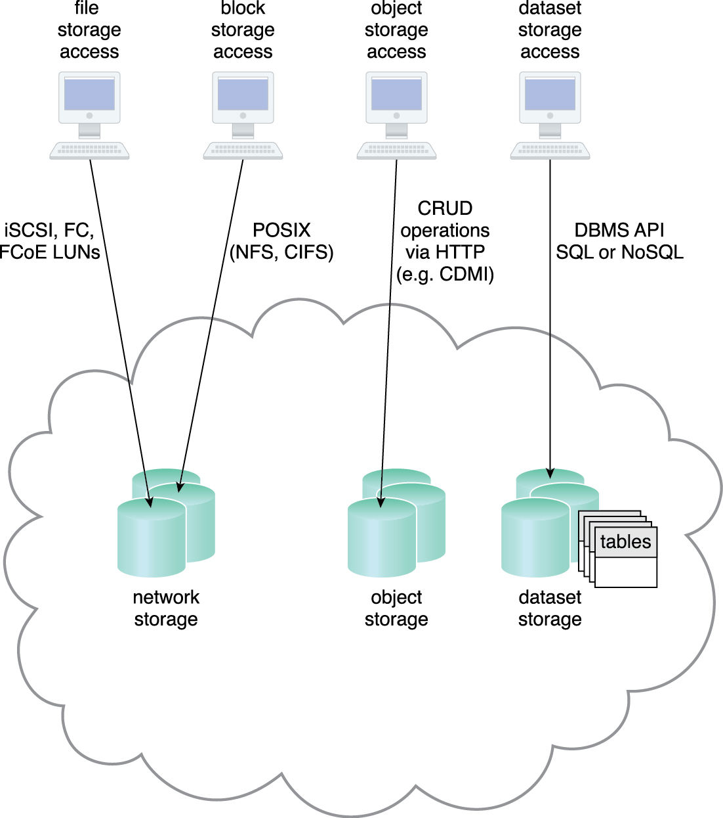
7.3. Cloud Storage Levels
Cloud storage device mechanisms provide common logical units of data storage, such as:
Files – Collections of data are grouped into files that are located in folders.
Blocks – The lowest level of storage and the closest to the hardware, a block is the smallest unit of data that is still individually accessible.
Datasets – Sets of data are organized into a table-based, delimited, or record format.
Objects – Data and its associated metadata are organized as Web-based resources.
Each of these data storage levels is commonly associated with a certain type of technical interface which corresponds to a particular type of cloud storage device and cloud storage service used to expose its API
Figure 7.9 Different cloud service consumers utilize different technologies to interface with virtualized cloud storage devices. (Adapted from the CDMI Cloud Storage Reference Model.)
Notes:
Figure:

Slide 17
7.3. Cloud Storage Device - Network Storage Interfaces
Legacy network storage most commonly falls under the category of network storage interfaces
Protocols are
SCSI for storage blocks and the server message block (SMB)
common Internet file system (CIFS)
network file system (NFS) for file and network storage
Storage of data files that have different sizes and formats
Performance will tend to be suboptimal for data searching and extraction when cloud storage is based on this type of interface
Block storage requires data to be in a fixed format (known as a data block), which is the smallest unit that can be stored and accessed and the storage format closest to hardware
Using either the logical unit number (LUN) or virtual volume block-level storage will typically have better performance than file-level storage

Slide 18
7.3. Cloud Storage Device - Object Storage Interfaces
Object Storage is various types of data can be referenced and stored as Web resources
technologies allows support for a range of data and media types
Cloud Storage Device mechanisms that implement this interface can typically be accessed via REST (representational state transfer) or Web service-based cloud services using HTTP as the prime protocol.

Slide 19
7.3. Cloud Storage Device - Database Storage Interfaces
Cloud storage device mechanisms based on database storage interfaces typically support a query language in addition to basic storage operations.
Storage management is carried out using a standard API or an administrative user-interface.
Relational Data Storage
Relational databases (or relational storage devices) rely on tables to organize similar data into rows and columns
Tables can have relationships with each other to give the data increased structure, to protect data integrity, and to avoid data redundancy (which is referred to as data normalization).
Working with relational storage commonly involves the use of the industry standard Structured Query Language (SQL).

Slide 20
7.3. Cloud Storage Device - Database Storage Interfaces
Relational Data Storage (cont.)
A cloud storage device mechanism implemented using IBM DB2, Oracle Database, Microsoft SQL Server, and MySQL
Scaling and performance is an issue with cloud-based relational databases
vertically can be more complex and cost-ineffective than horizontal scaling
Non-Relational Data Storage
moves away from the traditional relational database model in that it establishes a “looser” structure for stored data
avoid the potential complexity and processing overhead that can be imposed by relational databases
can be more horizontally scalable than relational storage.

Slide 21
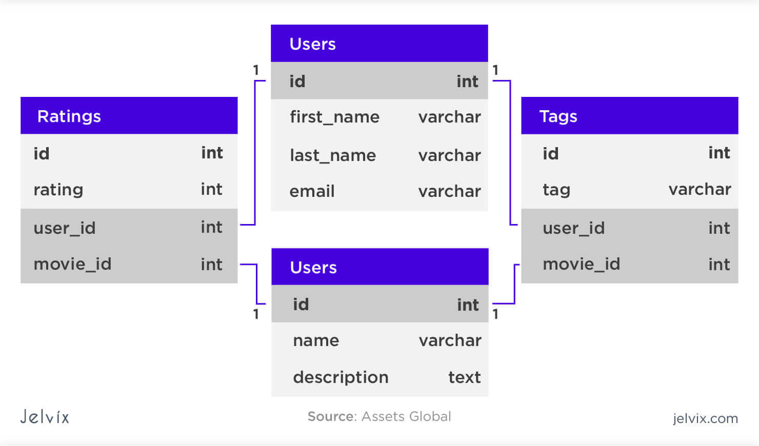
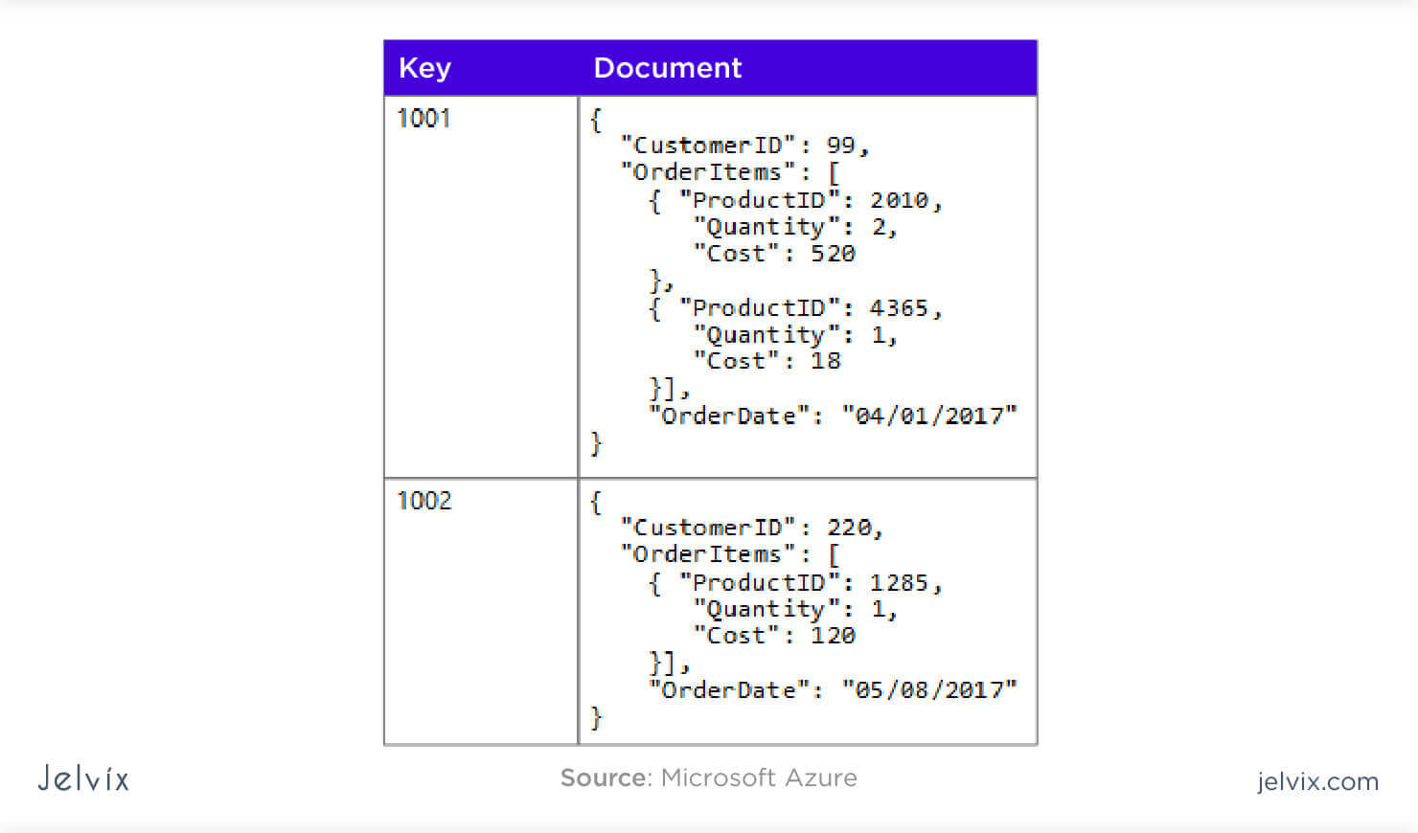
7.3. Cloud Storage Device - Database Storage Interfaces
Relational Database vs Non-Relational database

Slide 22
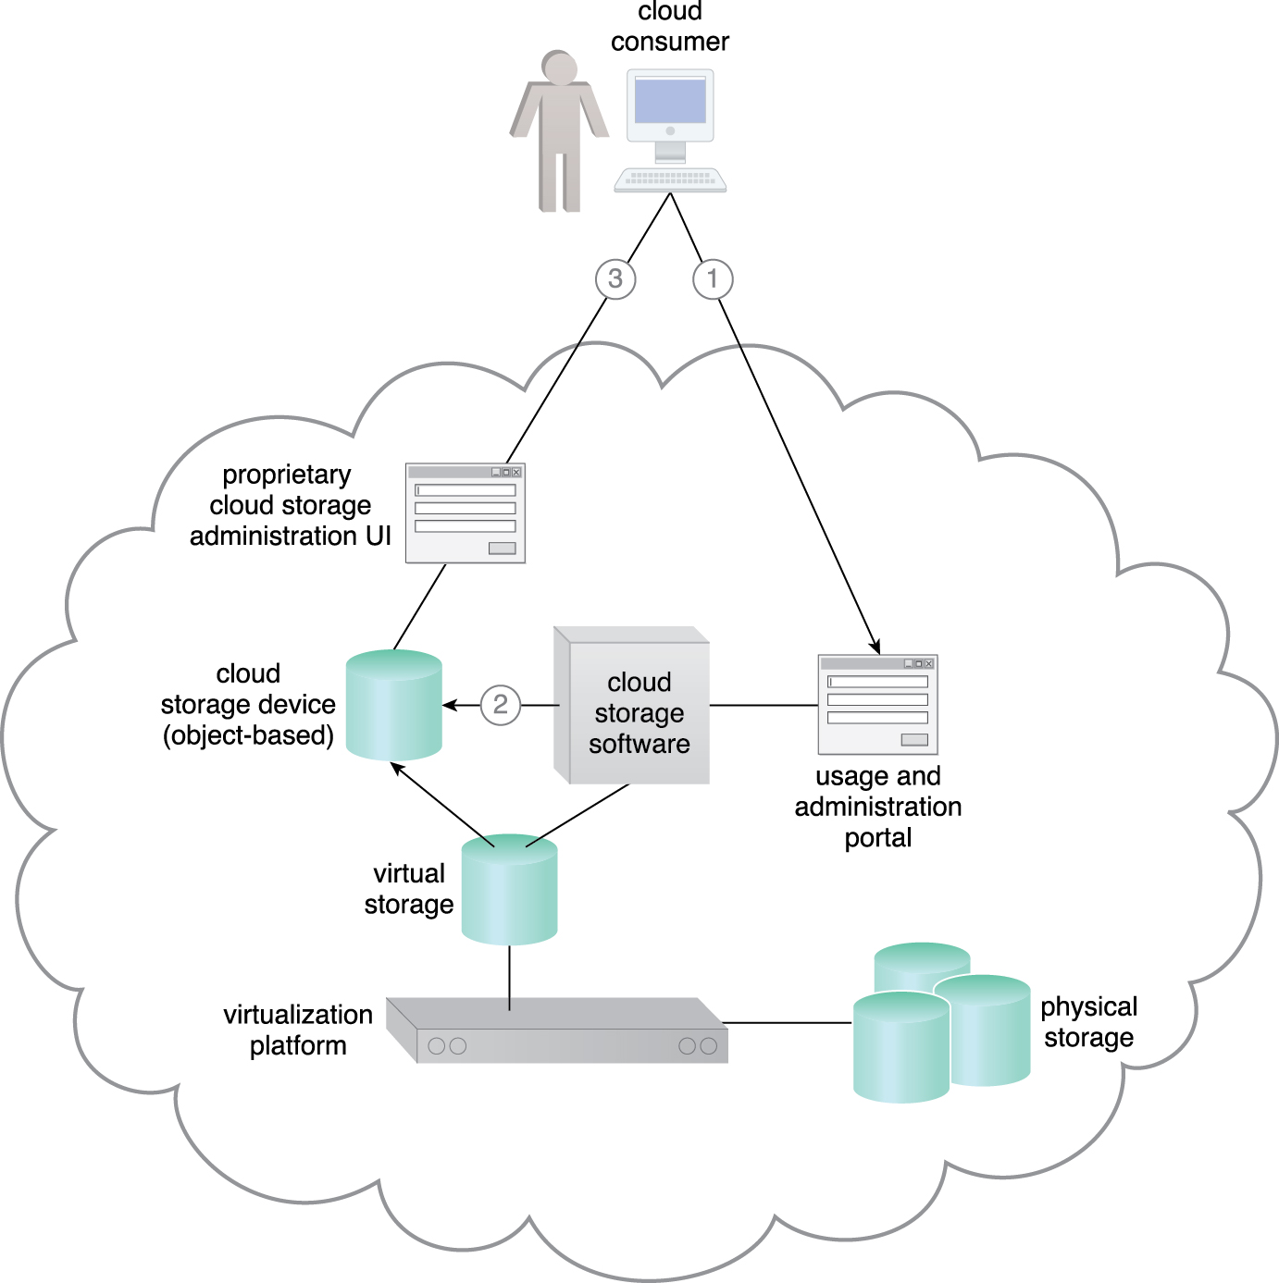
Case Study Example
The cloud consumer interacts with the usage and administration portal to create a cloud storage device and define access control policies (1).
The usage and administration portal interact with the cloud storage software to create the cloud storage device instance and apply the required access policy to its data objects (2)
Each data object is assigned to a cloud storage device and all of the data objects are stored in the same virtual storage volume. The cloud consumer uses the proprietary cloud storage device UI to interact directly with the data objects (3)
Figure 7.10
Notes:
Figure:

Slide 23
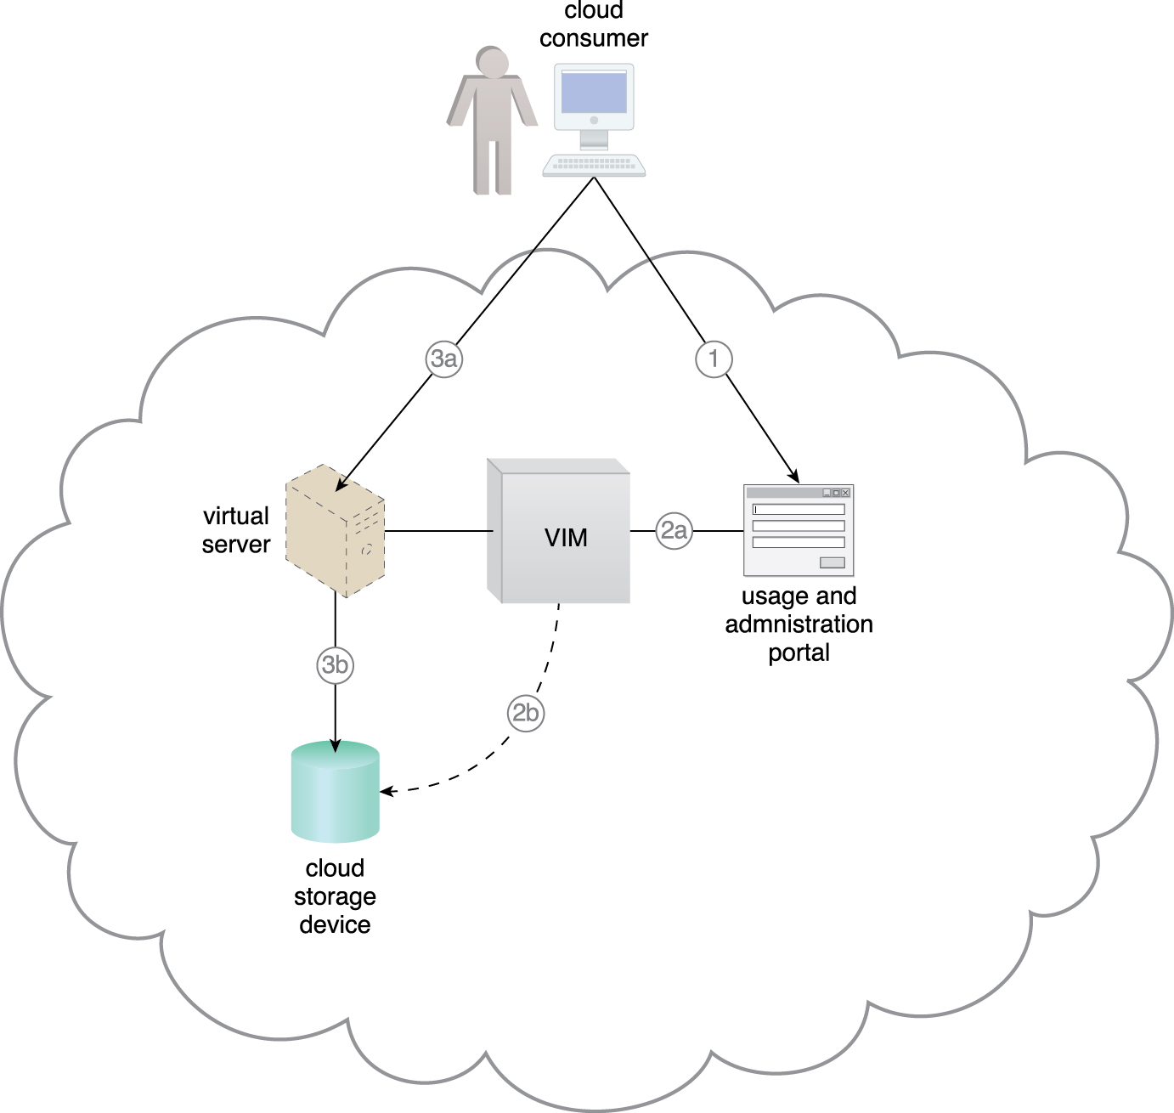
Case Study Example
The cloud consumer uses the usage and administration portal to create and assign a cloud storage device to an existing virtual server (1)
The usage and administration portal interacts with the VIM software (2a)
which creates and configures the appropriate LUN (2b).
Each cloud storage device uses a separate LUN controlled by the virtualization platform.
The cloud consumer remotely logs into the virtual server directly (3a)
to access the cloud storage device (3b).
Figure 7.11
Notes:
Figure:

Slide 24
7.4. Cloud Usage Monitor
The cloud usage monitor mechanism is a lightweight and autonomous software program responsible for collecting and processing IT resource usage data
Depending on the type of usage metrics they are designed to collect and the manner in which usage data needs to be collected, cloud usage monitors can exist in different formats
Notes:
Figure:

Slide 25
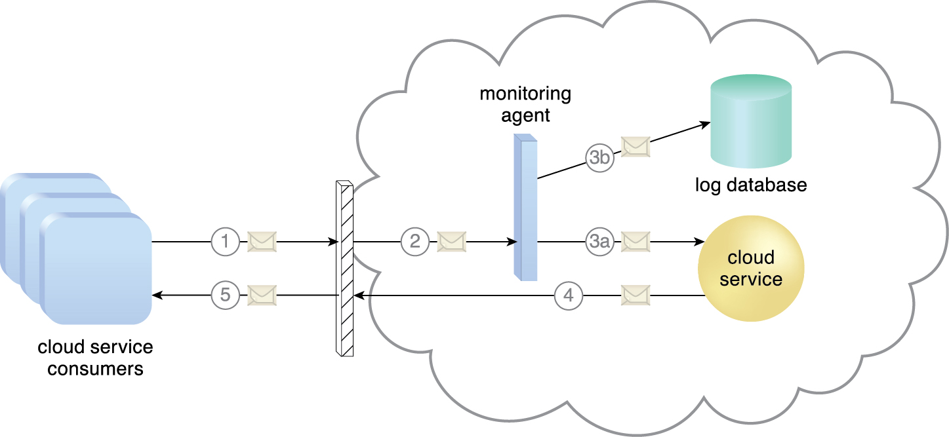
7.4. Cloud Usage Monitor - Monitoring Agent
A monitoring agent is an intermediary, event-driven program that exists as a service agent and resides along existing communication paths to transparently monitor and analyze dataflows
A cloud service consumer sends a request message to a cloud service (1)
The monitoring agent intercepts the message to collect relevant usage data (2)
before allowing it to continue to the cloud service (3a)
The monitoring agent stores the collected usage data in a log database (3b)
The cloud service replies with a response message (4)
that is sent back to the cloud service consumer without being intercepted by the monitoring agent (5).
Figure 7.12
Notes:
Figure:

Slide 26
7.4. Cloud Usage Monitor - Resource Agent
A resource agent is a processing module that collects usage data by having event-driven interactions with specialized resource software
This module is used to monitor usage metrics based on pre-defined, observable events at the resource software level, such as initiating, suspending, resuming, and vertical scaling
Notes:
Figure:

Slide 27
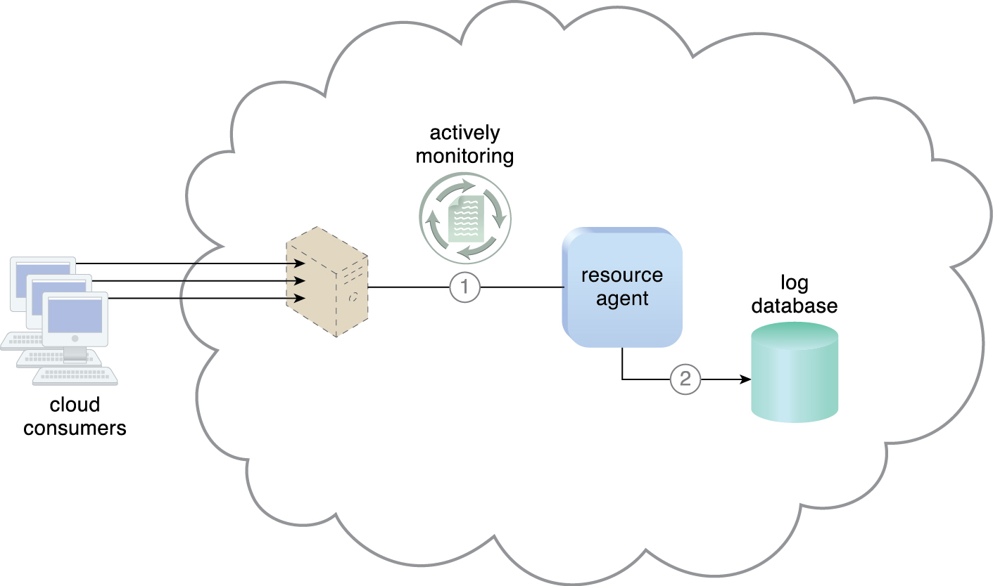
7.4. Cloud Usage Monitor - Resource Agent
The resource agent is actively monitoring a virtual server and detects an increase in usage (1)
The resource agent receives a notification from the underlying resource management program that the virtual server is being scaled up and stores the collected usage data in a log database, as per its monitoring metrics (2).
Figure 7.13
Notes:
Figure:

Slide 28
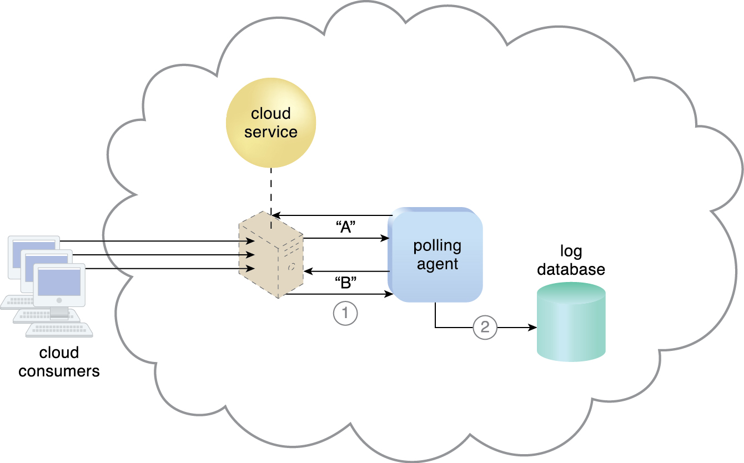
7.4. Cloud Usage Monitor - Polling Agent
A polling agent monitors the status of a cloud service hosted by a virtual server by sending periodic polling request messages and receiving polling response messages that report usage status “A” after a number of polling cycles, until it receives a usage status of “B” (1)
upon which the polling agent records the new usage status in the log database (2).
Figure 7.14
Notes:
Figure:

Slide 29
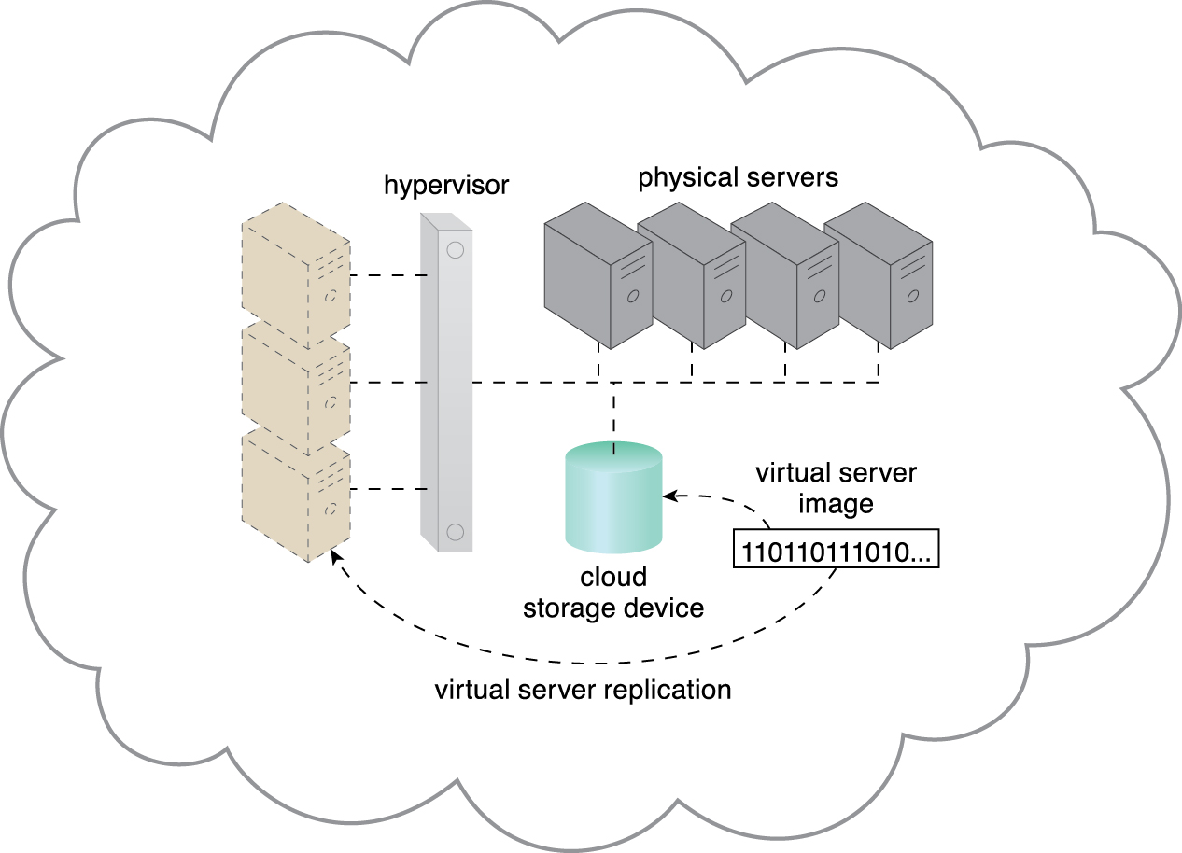
7.5. Resource Replication
Defined as the creation of multiple instances of the same IT resource, replication is typically performed when an IT resource’s availability and performance need to be enhanced
Virtualization technology is used to implement the resource replication mechanism to replicate cloud-based IT resources
Figure 7.16 The hypervisor replicates several instances of a virtual server, using a stored virtual server image.
Notes:
Figure:

Slide 30
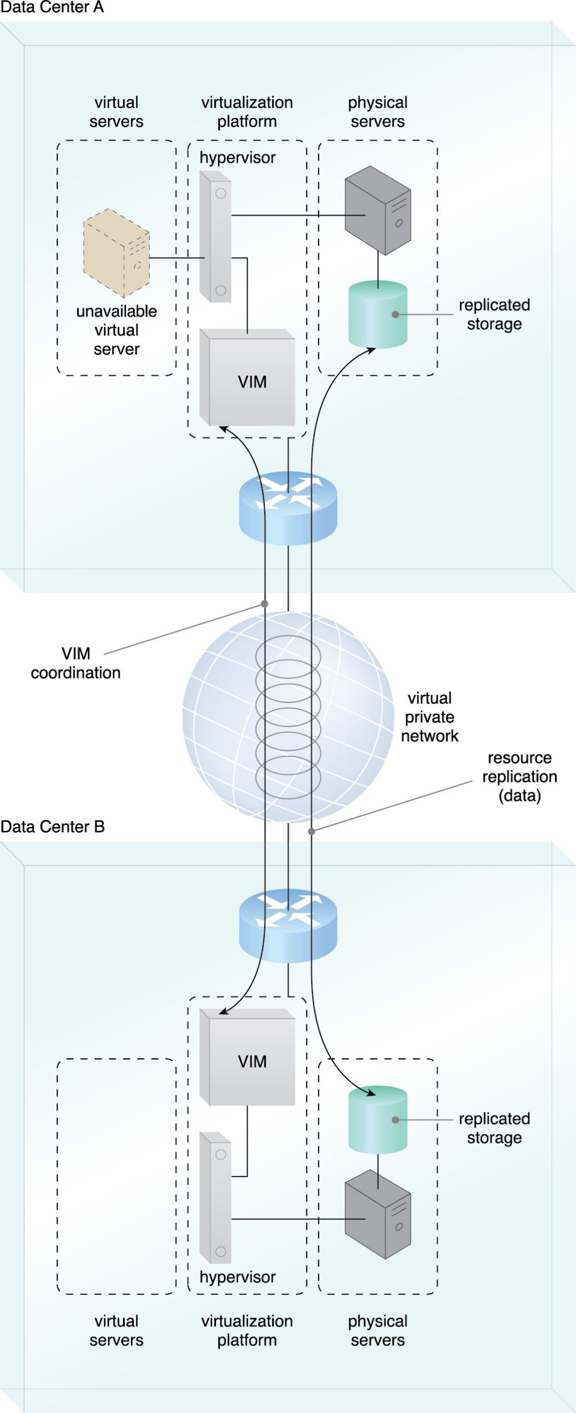
Case Study Example
A high-availability virtual server is running in Data Center A. VIM instances in Data Centers A and B are executing a coordination function that allows detection of failure conditions.
Stored VM images are replicated between data centers as a result of the high-availability architecture
Figure 7.17
Notes:
Figure:

Slide 31
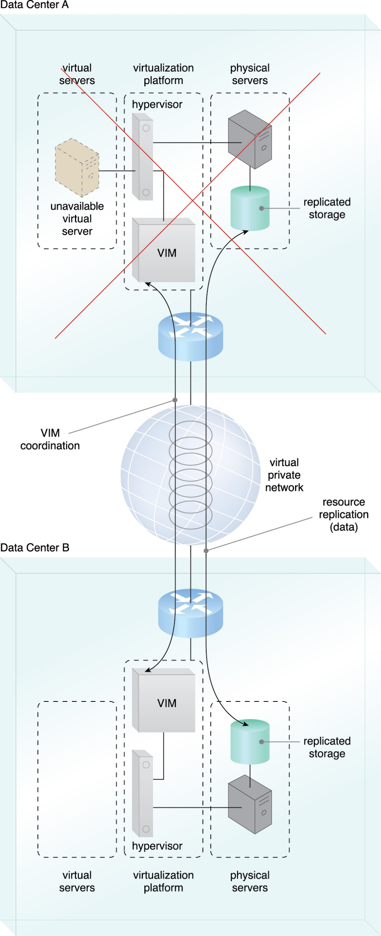
Case Study Example
The virtual server becomes unavailable in Data Center A
The VIM in Data Center B detects the failure condition and starts to reallocate the high-availability server from Data Center A to Data Center B.
Figure 7.18
Notes:
Figure:

Slide 32
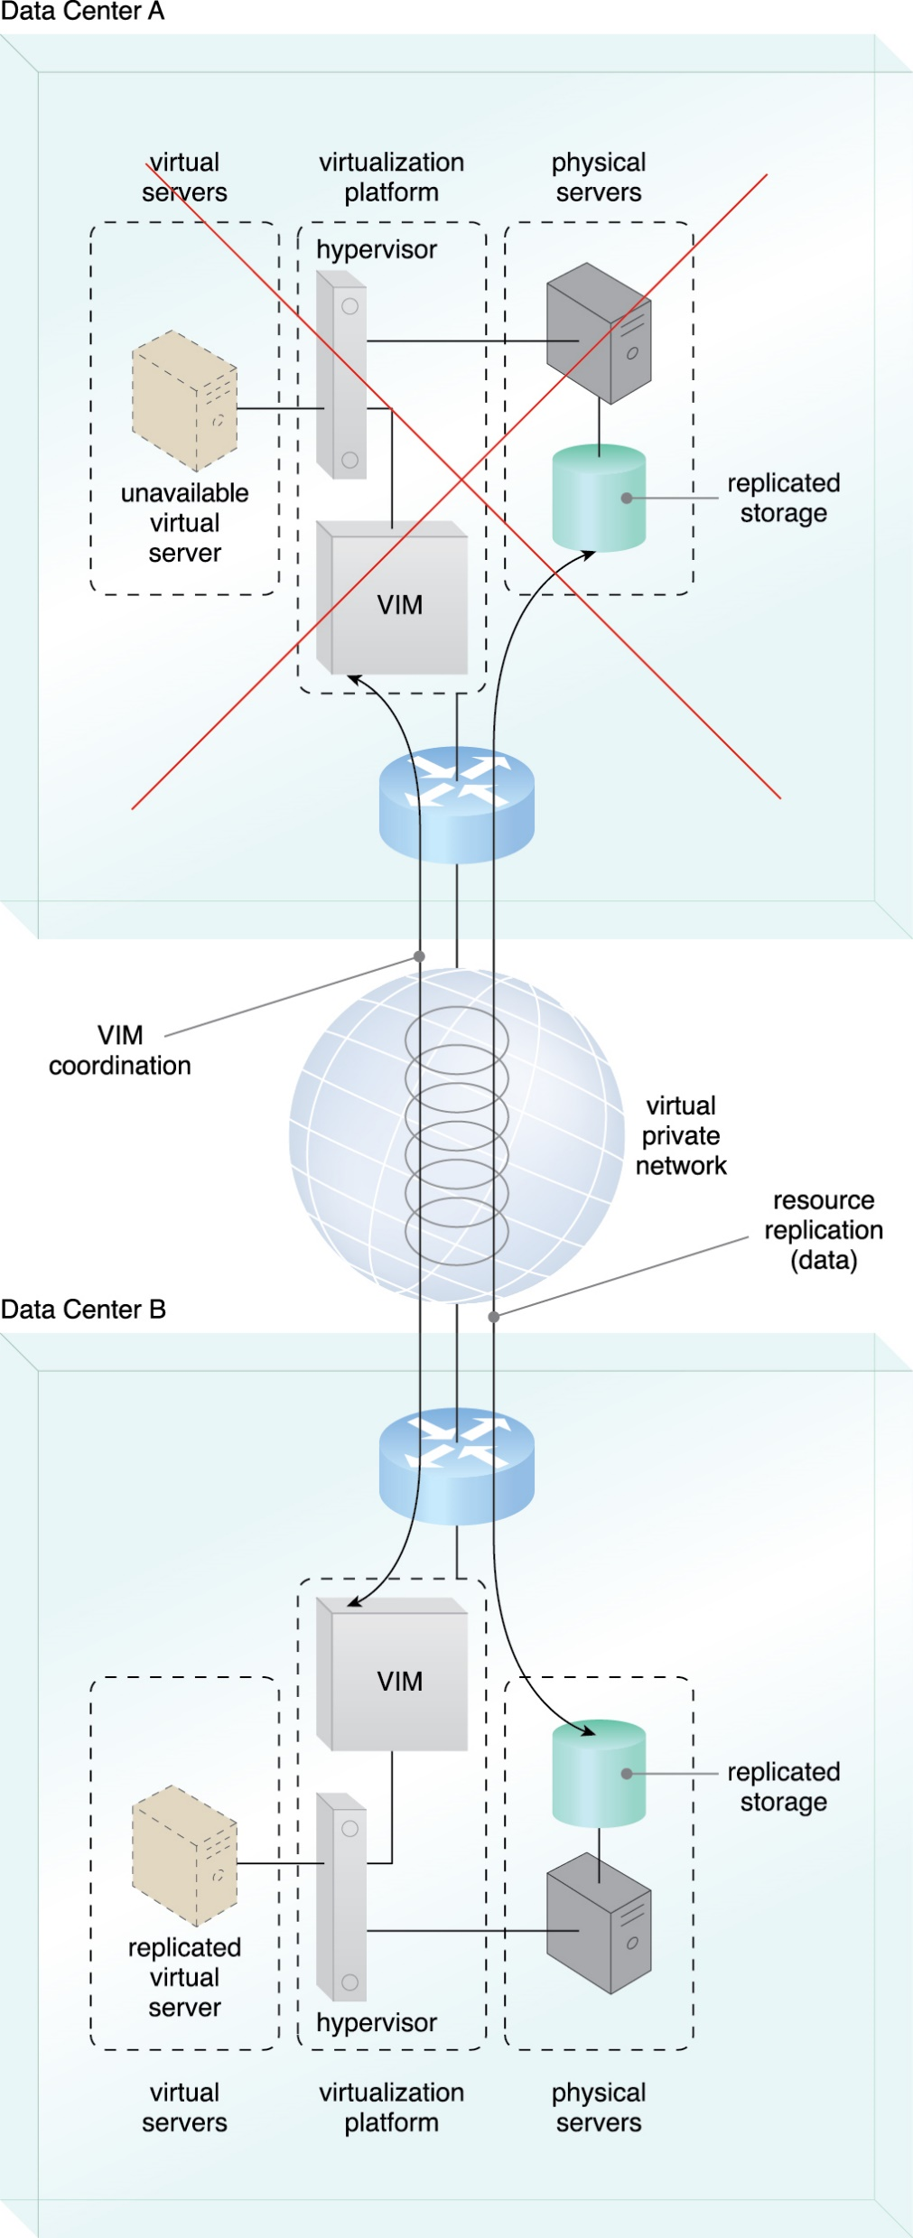
Case Study Example
A new instance of the virtual server is created and made available in Data Center B.
Figure 7.19
Notes:
Figure:

Slide 33
7.6. Ready-Made Environment
The ready-made environment mechanism is a defining component of the PaaS cloud delivery model that represents a pre-defined, cloud-based platform comprised of a set of already installed IT resources, ready to be used and customized by a cloud consumer
These environments are utilized by cloud consumers to remotely develop and deploy their own services and applications within a cloud
Typical ready-made environments include pre-installed IT resources, such as databases, middleware, development tools, and governance tools.
Has SDK
Notes:
Figure:

Slide 34
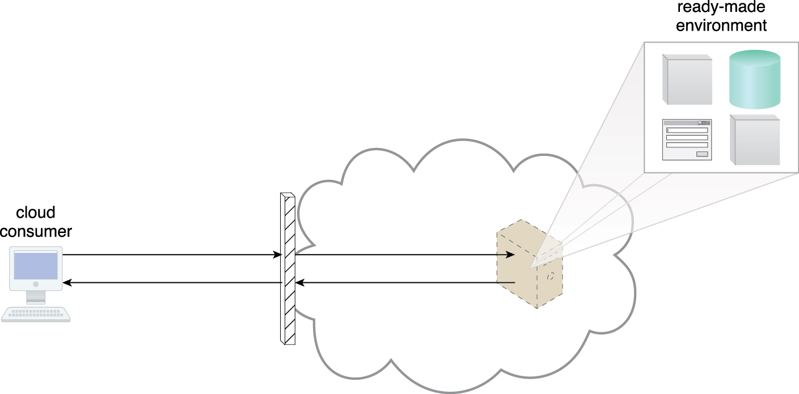
7.6. Ready-Made Environment
Figure 7.20 A cloud consumer accesses a ready-made environment hosted on a virtual server.
Notes:
Figure:

Slide 35
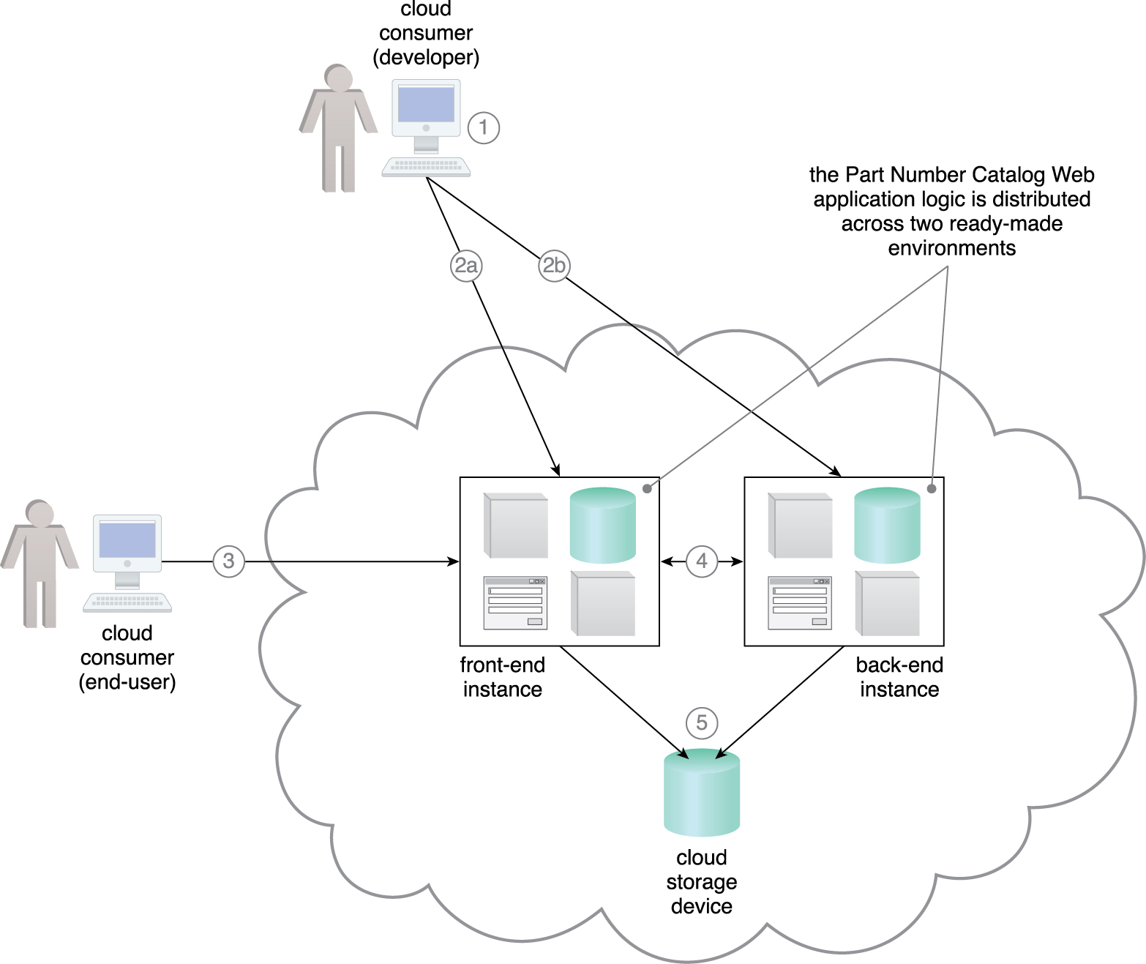
Case Study Example
The developer uses the provided SDK to develop the Part Number Catalog Web application (1)
The application software is deployed on a Web platform that was established by two ready-made environments called the front-end instance (2a) and the back-end instance (2b)
The application is made available for usage and one end-user accesses its front-end instance (3)
The software running in the front-end instance invokes a long-running task at the back-end instance that corresponds to the processing required by the end-user (4)
The application software deployed at both the front-end and back-end instances is backed by a cloud storage device that provides persistent storage of the application data (5).
Figure 7.21
Notes:
Figure:

